Slide 1


IBM Data Science Applied Data Science Capstone Optimal relocation
by Xavier Martinez
January 2020

Slide 2
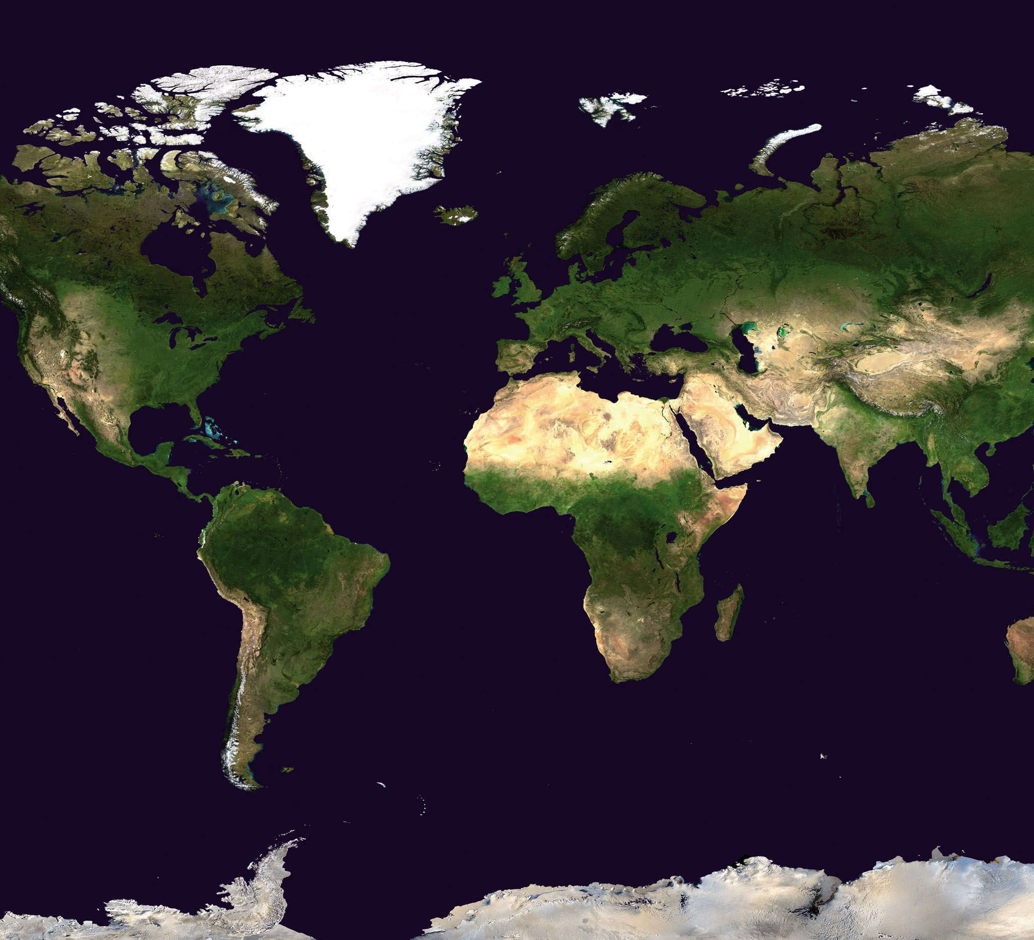

Optimal relocation 1. INTRODUCTION
“Each year, roughly 40 million Americans, or about 14 percent of the U.S. population, move at least once”
Michael B. Sauter 2018
OBJECTIVE
The objective of this project is to develop a tool that would allow identifying the area in a city or cities that best matches the requirements of an individual that will be relocating.

Slide 3



Optimal relocation 2. DATA
SOURCES OF DATA
data related to venues will be obtained from Foursquare
data related to the transformation from address
to geographical coordinates
data related to the quality of life, cost of living, safety,
health care, climate and pollution

Slide 4
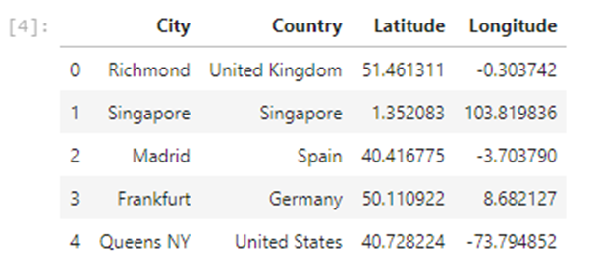
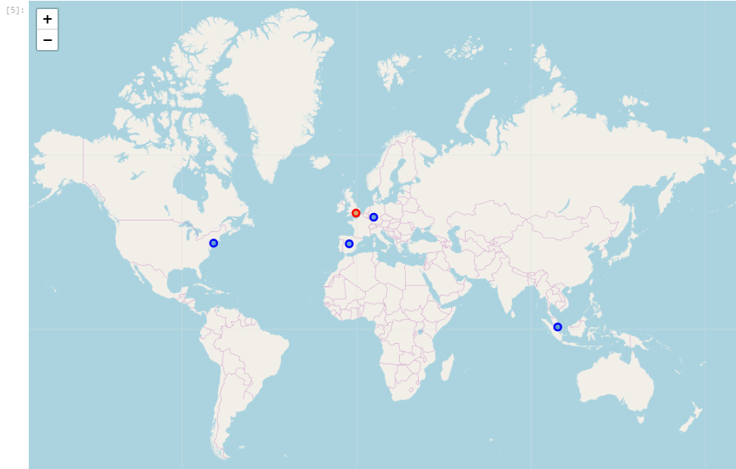
Optimal relocation 2. DATA
Madrid (Spain)
Frankfurt (Germany)
Singapore (Singapore)
Queens NY, United States
EXAMPLE IMPLEMENTED
Richmond (United Kingdom)

Slide 5
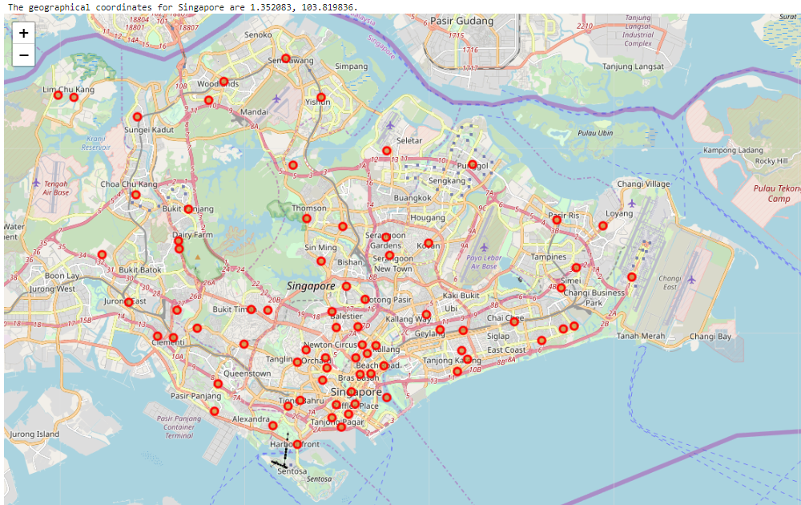
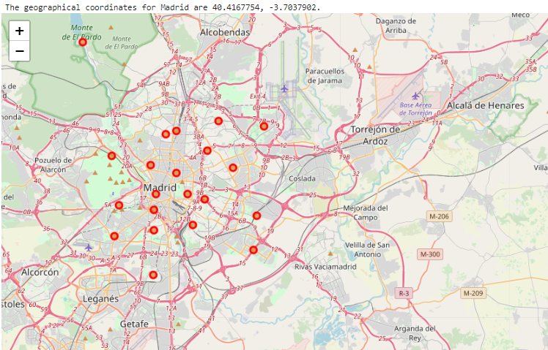
Optimal relocation 4. RESULTS
4.1 COLLECT NEIGHBOURHOODS COORIDNATES
Singapore (Singapore) Madrid (Spain)

Slide 6
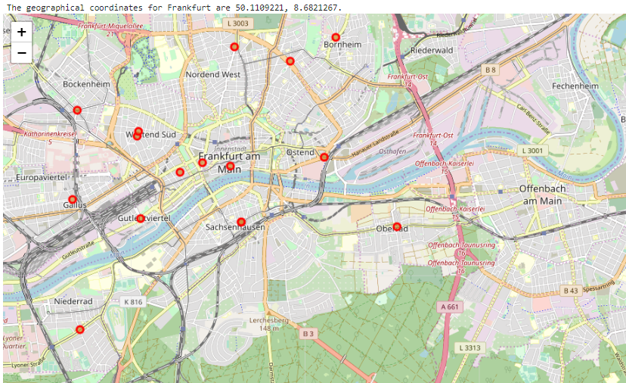
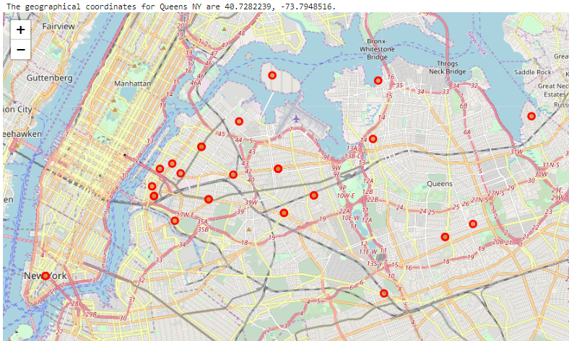
Optimal relocation 4. RESULTS
4.1 COLLECT NEIGHBOURHOODS COORIDNATES
Frankfurt (Germany) Queens NY (United States)

Slide 7
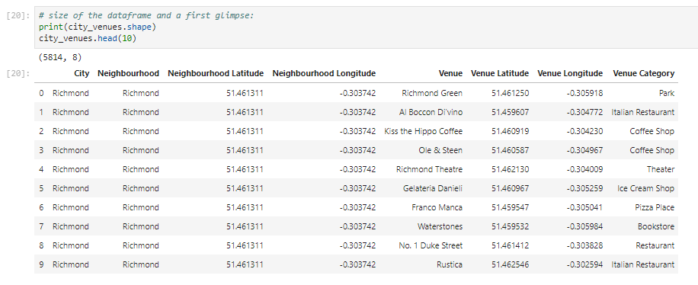
Optimal relocation 4. RESULTS
4.2 COLLECT VENUES
All venues information is stored in a dataframe

Slide 8
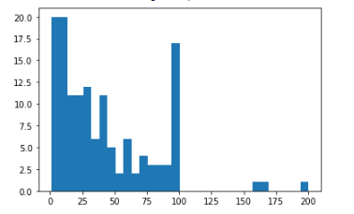
Optimal relocation 4. RESULTS
4.3 ANALISE AND REDEFINE VENUES’ CATEGORIES
Number of venues Histogram of number of venues
Threshold of venues per neighborhood: 20
Neighborhoods with less than 20 venues: 51
Number of registers before removal: 5814
Number of registers after removal: 5304
Number of categories
Number of categories before redefine: 344
Number of categories after redefine: 11

Slide 9
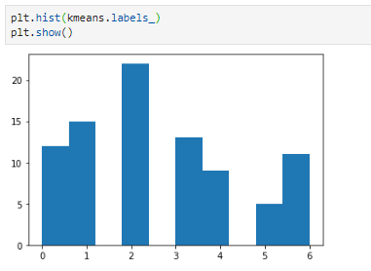
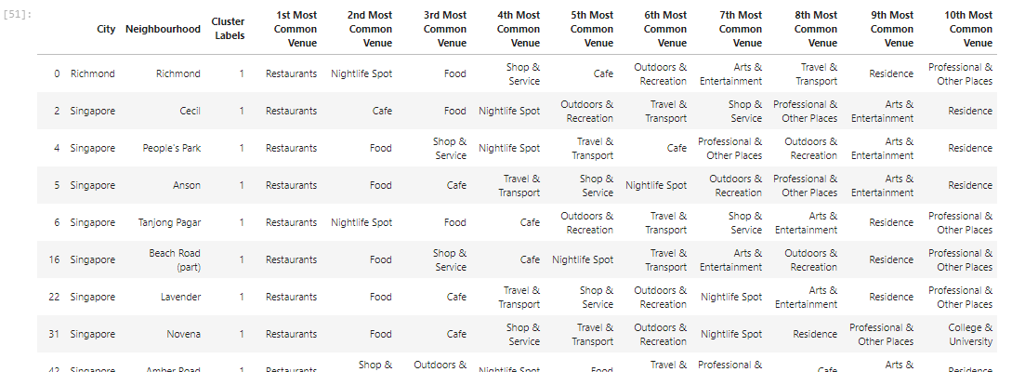
Optimal relocation 4. RESULTS
4.4 CLUSTER NEIGHBOURHOODS
Clustering engine: k-means (from sk-learn) Histogram of number neighborhood per cluster
Number of clusters: 7
Richmond is in cluster num. 1

Slide 10
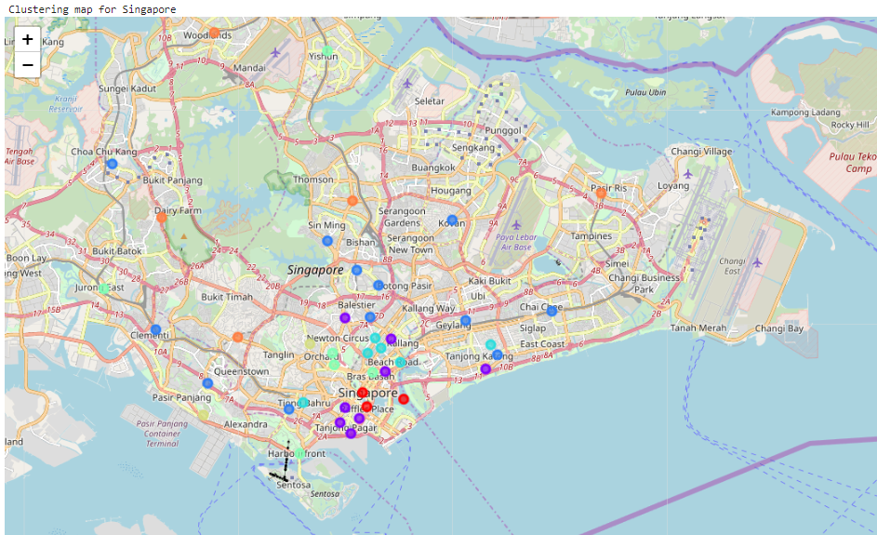
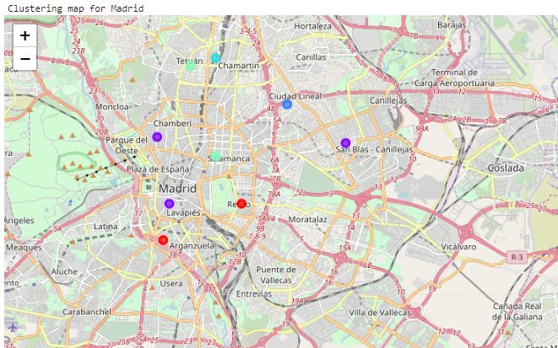
Optimal relocation 4. RESULTS
4.6 CLUSTER NEIGHBOURHOODS
Singapore (Singapore) Madrid (Spain)

Slide 11
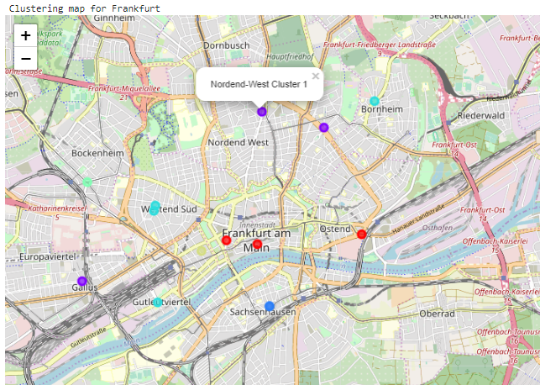
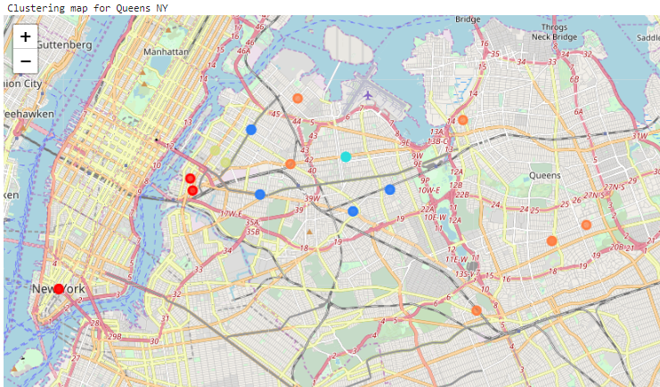
Optimal relocation 4. RESULTS
4.6 CLUSTER NEIGHBOURHOODS
Frankfurt (Germany) Queens NY (United States)

Slide 12
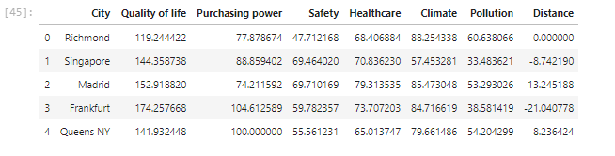
Optimal relocation 4. RESULTS
4.5 COLLECT INDICES AND CALDULATE DISTANCE

Slide 13
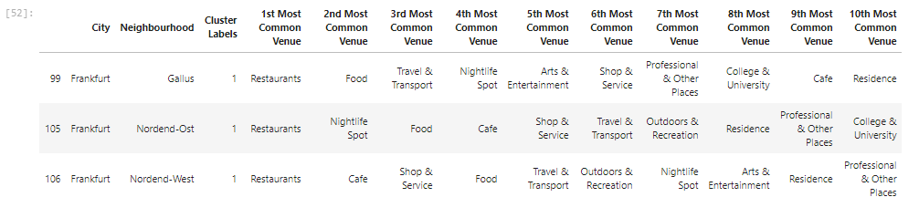
Optimal relocation 4. RESULTS
4.8 RECOMMENDATION
1st criteria. Clustering: CLUSTER NUM 1
2nd criteria. Distance: FRANKFURT (GERMANY)

Slide 14
Optimal relocation 6. CONCLUSIONS
CONCLUSIONS:
The tool developed is robust enough to undertake an initial analysis of the preferred relocation places.
The methodology used can be applied to any other cities.
There are clear potential lines of further development of the tool, that would allow refining the selection.
FUTURE DEVELOPMENT:
Capture individual requirements in more detail
Consider more than one city of reference
Alter the venues information gathered to highlight strong individual opinions
Customise to more detail the lists of categories
Develop a more uniformly distributed grid or potential areas for relocating
Considering not only the number of venues but also considering their scoring.
Develop granularity of the indices across the cities.

Slide 15
IBM Data Science Applied Data Science Capstone Optimal relocation
Thank you
by Xavier Martinez
January 2020

